Slide 1
Chapter 10: File-System Interface

Slide 2
Chapter 10: File-System Interface
File Concept
Access Methods
Directory Structure
File Sharing
Protection

Slide 3
Objectives
To explain the function of file systems
To describe the interfaces to file systems
To discuss file-system design tradeoffs, including access methods, file sharing, file locking, and directory structures
To explore file-system protection

Slide 4

Name – only information kept in human-readable form
Identifier – unique tag (number) identifies file within file system
Type – needed for systems that support different types
Location – pointer to file location on device
Size – current file size
Protection – controls who can do reading, writing, executing
Time, date, and user identification – data for protection, security, and usage monitoring
Information about files are kept in the directory structure, which is maintained on the disk

Slide 5

Create
Write
Read
Reposition within file
Delete
Truncate
Open(F_{i}) – search the directory structure on disk for entry F_{i}, and move the content of entry to memory
Close (F_{i}) – move the content of entry F_{i} in memory to directory structure on disk

Slide 6

Several pieces of data are needed to manage open files:
  File pointer: pointer to last read/write location, per process that has the file open
  File-open count: counter of number of times a file is open – to allow removal of data from open-file table when last processes closes it
  Disk location of the file: cache of data access information
  Access rights: per-process access mode information

Slide 7

File Types – Name, Extension

Slide 8

Sequential Access
read next
write next
reset
no read after last write
(rewrite)
Direct Access
read n
write n
position to n
read next
write next
rewrite n
n = relative block number

Slide 9

Sequential-access File

Slide 10
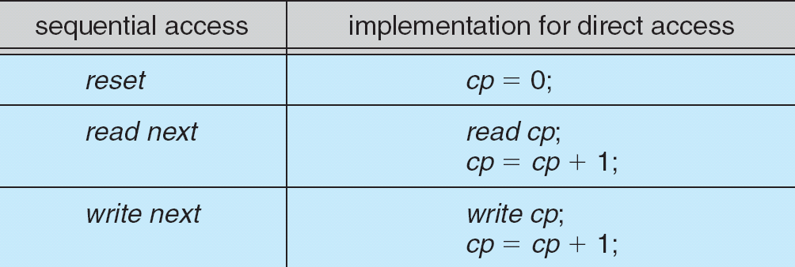
Simulation of Sequential Access on a Direct-access File

Slide 11

A Typical File-system Organization
Could use entire disk for FS, but
  system could have multiple FS types (e.g., swap)
Disk divided into miniature disks called partitions or slices

Slide 12
Directory Structure
A collection of nodes containing information about all files
Directory
Files
F 1
F 2
F 3
F 4
F n
Both the directory structure and the files reside on disk

Slide 13
Operations Performed on Directory
List directory contents
Search for a file
Create a file
Delete a file
Rename a file
Traverse the file system

Slide 14
Organize the Directory (Logically) to Obtain
Efficiency – locating a file quickly
Naming – convenient to users
  Two users can have same name for different files
  The same file can have several different names
Grouping – logical grouping of files by properties, (e.g., all Java programs, all games, …)

Slide 15

Single-Level Directory
A single directory for all users
  Called the root directory
Pros: Simple, easy to quickly locate files
Cons: inconvenient naming (uniqueness), no grouping

Slide 16

Two-Level Directory
Separate directory for each user
Introduces the notion of a path name
Can have the same file name for different user
Efficient searching
No grouping capability

Slide 17

Tree-Structured Directories
Directories can now contain files and subdirectories
Efficient searching, allows grouping

Slide 18
Path Names
To access a file, the user should either:
  Go to the directory where file resides, or
  Specify the path where the file is
Path names are either absolute or relative
  Absolute: path of file from the root directory
  Relative: path from the current working directory
Most OSes have two special entries in each directory:
  “.” for current directory and “..” for parent

Slide 19

Acyclic-Graph Directories
Allow sharing of subdirectories and files

Slide 20
Acyclic-Graph Directories (Cont.)
Two different names (aliasing)
If dict deletes list ⇒ dangling pointer
Solutions:
  Backpointers, so we can delete all pointers
  Variable size records a problem
  Backpointers using a daisy chain organization
  Reference count for each file
New directory entry type
  Link – another name (pointer) to an existing file
  Resolve the link – follow pointer to locate the file

Slide 21

General Graph Directory

Slide 22
General Graph Directory (Cont.)
How do we guarantee no cycles?
  Allow only links to files not subdirectories
  Garbage collection
  Every time a new link is added use a cycle detection algorithm to determine whether it is OK

Slide 23
Protection
File owner/creator should be able to control:
  what can be done
  by whom
Types of access
  Read
  Write
  Execute
  Append
  Delete
  List

Slide 24
Categories of Users
Individual user
  Log in establishes a user-id
  Might be just local on the computer or could be through interaction with a network service
Groups to which the user belongs
  For example, “nahum” is in “w4118”
  Again could just be automatic or could involve talking to a service that might assign, say, a temporary cryptographic key

Slide 25
UNIX Access Rights
Mode of access: read, write, execute
Three classes of users
RWX
a) owner access 7 ⇒ 1 1 1
RWX
b) group access 6 ⇒ 1 1 0
RWX
c) public access 1 ⇒ 0 0 1
Ask manager to create a group (unique name), say G, and add some users to the group.
For a particular file (say game) or subdirectory, define an appropriate access.
owner
group
public
chmod
761
game

Slide 26
Issues with UNIX Access Rights
Just a single owner, a single group and the public
  Pro: Compact enough to fit in just a few bytes
  Con: Not very expressive
Access Control List: This is a per-file list that tells who can access that file
  Pro: Highly expressive
  Con: Harder to represent in a compact way

Slide 27
End of Chapter 10

